Slide 1
CS209: Computer Science II

Slide 2
Unit 2 Module 3:
Linked Lists
Introduction to the Linked List
Linked List Operations
A Linked List Template
Variations of the Linked List

Slide 3

Introduction to the Linked List ADT
Can grow and shrink
Fast insert and delete
Self-referential data structure - This structure makes it possible to create links that point to other links of the same type.

Slide 4
Introduction to the Linked List ADT
Linked list: set of data structures (nodes) that contain references to other data structures
null
list
head

Slide 5
Introduction to the Linked List ADT
References may be addresses or array indices
Data structures can be added to or removed from the linked list during execution
newNode
list
head
null

Slide 6
Linked Lists vs. Arrays and Vectors
Linked lists can grow and shrink as needed, unlike arrays, which have a fixed size
Linked lists can insert a node between other nodes easily
null
list
head

Slide 7
Node Organization
A node contains:
data: one or more data fields – may be organized as structure, object, etc.
a pointer that can point to another node
pointer
data

Slide 8
Linked List Organization
Linked list contains 0 or more nodes:
Has a list head to point to first node
Last node points to null(address 0)
null
list
head

Slide 9
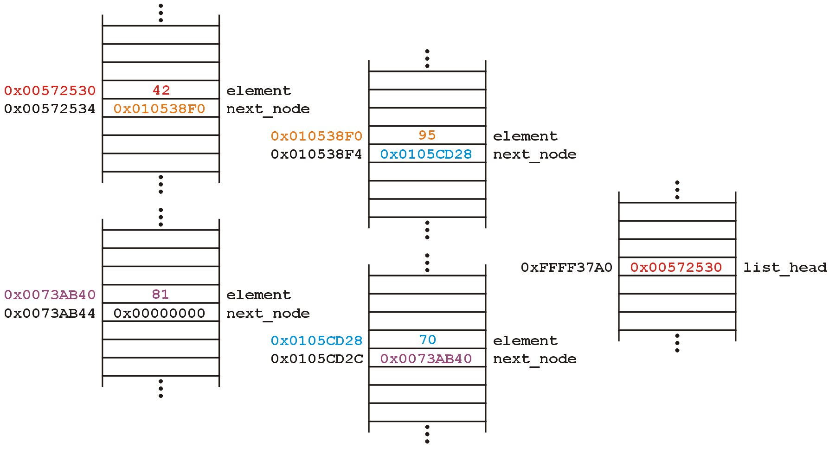
Linked List Structure
Linked List Object

Slide 10
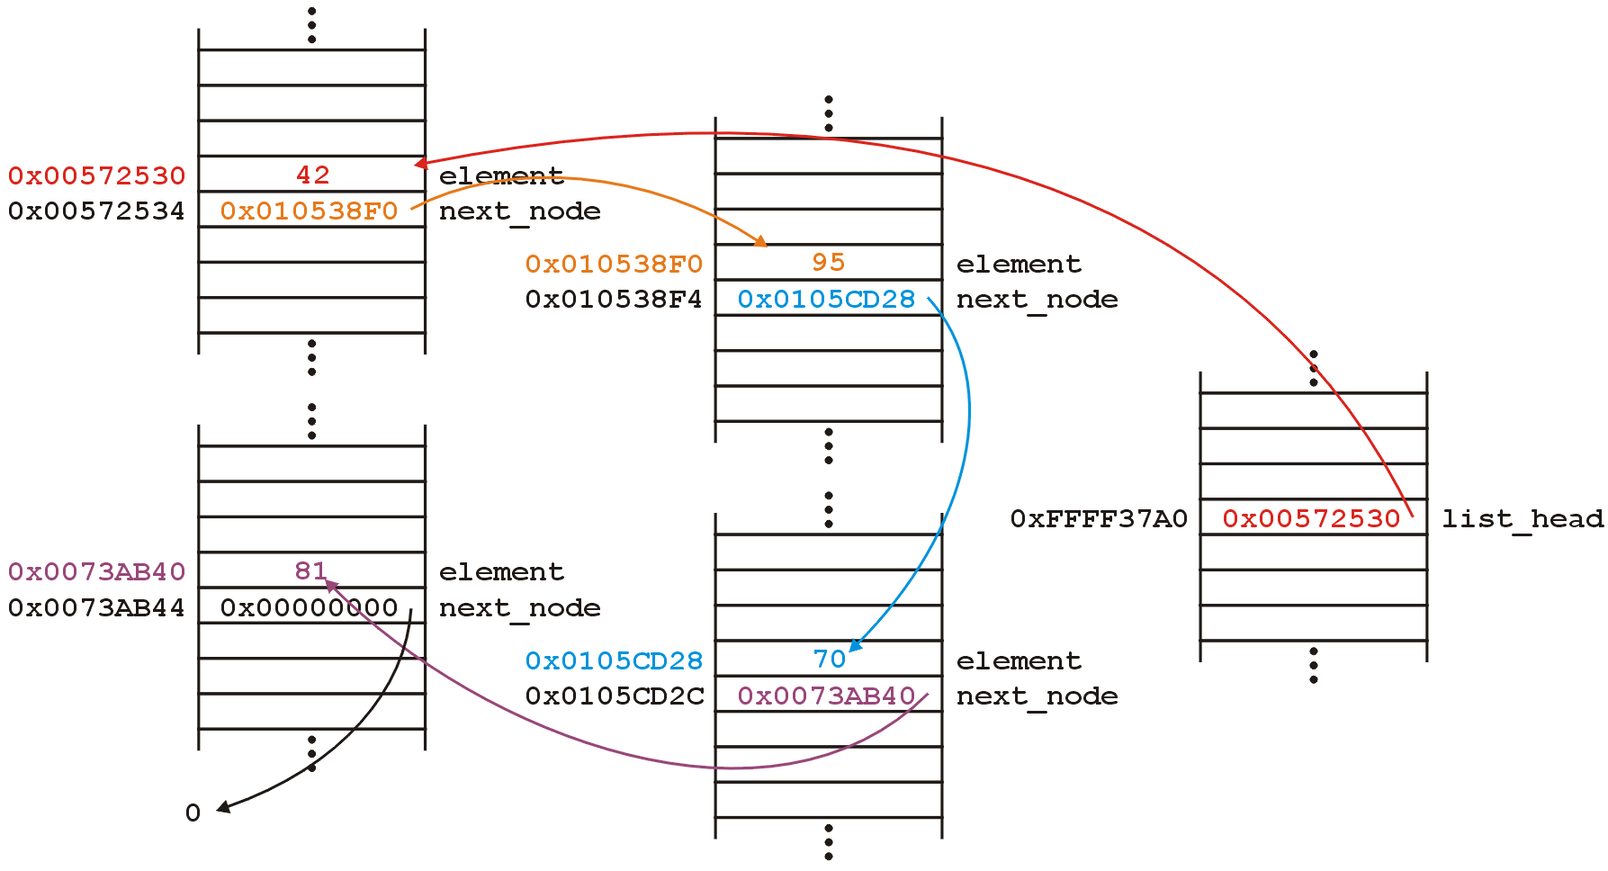
Linked List Structure

Slide 11
Linked List Structure
Alternate representation
We do not specify the addresses because they are arbitrary and:
The contents of the circle is the element
The pointer is represented by an arrow

Slide 12
Empty List
If a list currently contains 0 nodes, it is the empty list
In this case the list head points to null
list
head
NULL

Slide 13
Caution!
Always make sure that your linked list functions work correctly with an empty list.
EMPTY LIST

Slide 14
Declaring a Node
Declare a node:
struct ListNode
{
int data;
ListNode *next;
};
No memory is allocated at this time

Slide 15
Defining a Linked List
Define a pointer for the head of the list:
ListNode *head = nullptr;
Head pointer initialized to nullptr to indicate an empty list
head
null

Slide 16
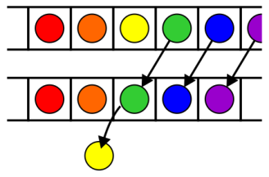

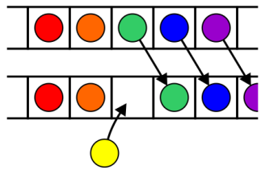
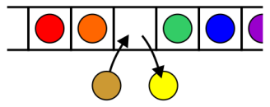
Operations
Operations at the k^{th} entry of the list include:
Access to the object Erasing an object
Insertion of a new object Replacement of the object

Slide 17
The Null Pointer
Is used to indicate end-of-list
Should always be tested for before using a pointer:
ListNode *p;
while (!p)

Slide 18
Declaring a Node
struct ListNode
{
string item;
int count;
ListNode *link;
}
Typedef ListNode* ListNodePtr;
ListNodePtr head;

Slide 19
Linked List Operations
Basic operations:
append a node to the end of the list
insert a node within the list
traverse the linked list
delete a node
delete/destroy the list

Slide 20
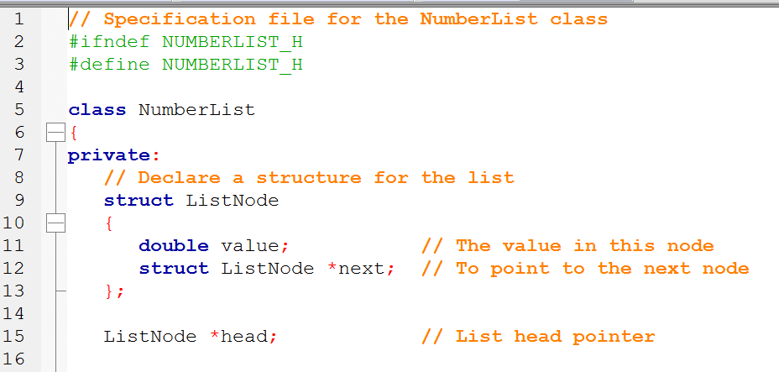

Slide 21
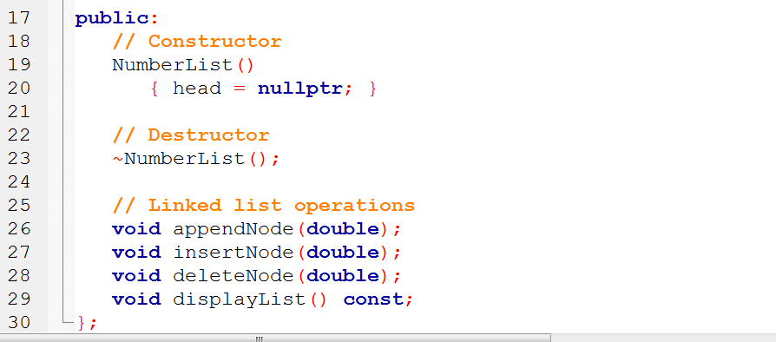
Contents of NumberList.hpp

Slide 22
Create a New Node
newNode
Allocate memory for the new node:
newNode = new ListNode;
Initialize the contents of the node:
newNode->value = num;
Set the pointer field to nullptr:
newNode->next = nullptr;
newNode
23
newNode
23
null

Slide 23
Appending a Node
Add a node to the end of the list
Basic process:
Create the new node (as already described)
Add node to the end of the list:
If list is empty, set head pointer to this node
Else,
traverse the list to the end
set pointer of last node to point to new node

Slide 24
Appending a Node
nodePtr
5
13
19
null
list
head
23
null
newNode
New node created, end of list located

Slide 25
Appending a Node
nodePtr
5
13
19
list
head
23
null
newNode
New node added to end of list

Slide 26
C++ code for Appending a Node
11 void NumberList::appendNode(double num) 12 { 13 ListNode *newNode; // To point to a new node 14 ListNode *nodePtr; // To move through the list 15 16 // Allocate a new node and store num there. 17 newNode = new ListNode; 18 newNode->value = num; 19 newNode->next = nullptr; 20 21 // If there are no nodes in the list 22 // make newNode the first node. 23 if (!head)

Slide 27
C++ code for Appending a Node (Continued)
24 head = newNode; 25 else // Otherwise, insert newNode at end. 26 { 27 // Initialize nodePtr to head of list. 28 nodePtr = head; 29 30 // Find the last node in the list. 31 while (nodePtr->next) 32 nodePtr = nodePtr->next; 33 34 // Insert newNode as the last node. 35 nodePtr->next = newNode; 36 } 37 }

Slide 28
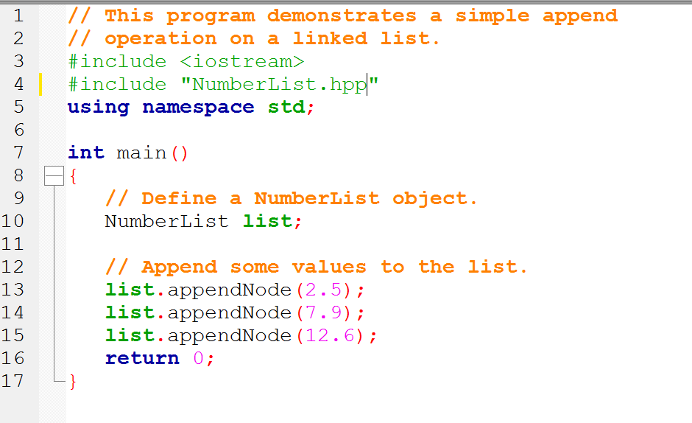

Slide 29
1
newNode = new ListNode; newNode->value = num; newNode->next = nullptr;
null
list
head
2.5
null
2
if (!head)
head = newNode;
2.5
null
list
head

Slide 30
1
newNode = new ListNode; newNode->value = num; newNode->next = nullptr;
7.9
null
list
head
2.5
null
2
else { nodePtr = head; while (nodePtr->next)
nodePtr = nodePtr->next; nodePtr->next = newNode; }
nodePtr
nodePtr->next

Slide 31
1
newNode = new ListNode; newNode->value = num; newNode->next = nullptr;
7.9
null
list
head
2.5
12.6
null
else { nodePtr = head; while (nodePtr->next)
nodePtr = nodePtr->next; nodePtr->next = newNode; }
nodePtr
2

Slide 32
nodePtr
7.9
list
head
2.5
12.6
null
else { nodePtr = head; while (nodePtr->next)
nodePtr = nodePtr->next; nodePtr->next = newNode; }

Slide 33
Inserting a Node into a Linked List
Used to maintain a linked list in order
Requires two pointers to traverse the list:
pointer to locate the node with data value greater than that of node to be inserted
pointer to 'trail behind' one node, to point to node before point of insertion
New node is inserted between the nodes pointed at by these pointers

Slide 34
Inserting a Node into a Linked List
previousNode
nodePtr
5
13
19
null
list
head
17
null
newNode
New node created, correct position located

Slide 35
Inserting a Node into a Linked List
previousNode
nodePtr
5
13
19
null
list
head
17
newNode
New node inserted in order in the linked list

Slide 36
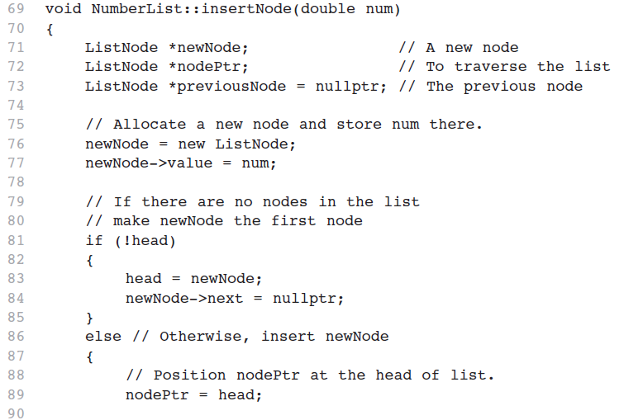

Slide 37
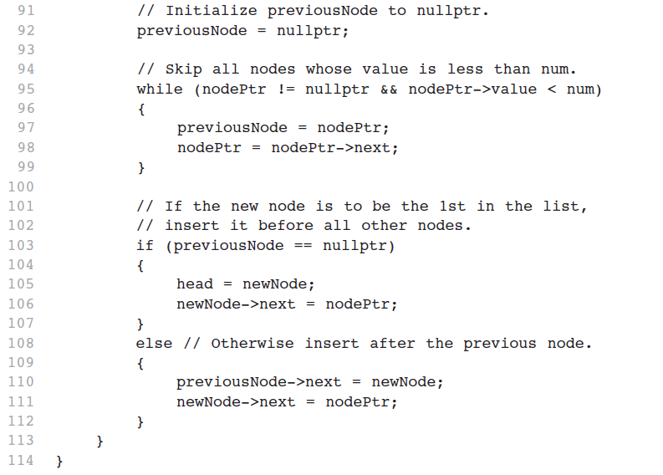

Slide 38
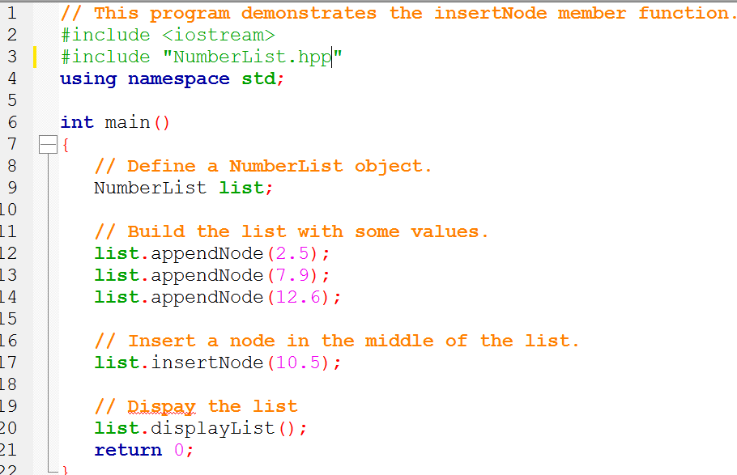

Slide 39
Traversing a Linked List
Visit each node in a linked list: display contents, validate data, etc.
Basic process:
set a pointer to the contents of the head pointer
while pointer is not a null pointer
process data
go to the next node by setting the pointer to the pointer field of the current node in the list
end while

Slide 40
Traversing a Linked List
nodePtr
5
13
19
null
list
head
nodePtr points to the node containing 5, then the
node containing 13, then the node containing 19,
then points to the null pointer, and the list traversal stops

Slide 41
Deleting a Node
Used to remove a node from a linked list
If list uses dynamic memory, then delete node from memory
Requires two pointers: one to locate the node to be deleted, one to point to the node before the node to be deleted

Slide 42
Deleting a Node
previousNode
nodePtr
5
13
19
null
list
head
Locating the node containing 13

Slide 43
Deleting a Node
previousNode
nodePtr
5
13
19
null
list
head
Adjusting pointer around the node to be deleted

Slide 44
Deleting a Node
previousNode
nodePtr
5
19
null
list
head
Linked list after deleting the node containing 13

Slide 45
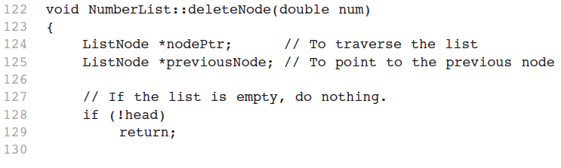

Slide 46
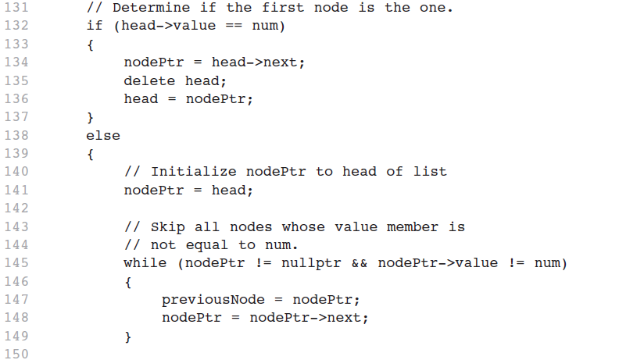

Slide 47
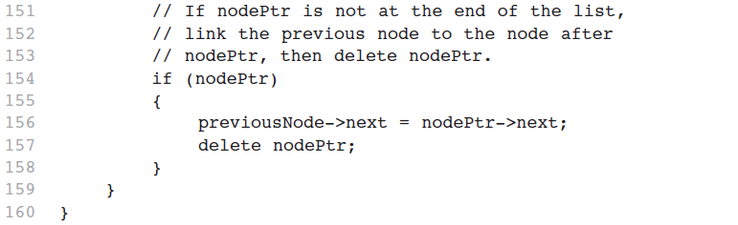

Slide 48
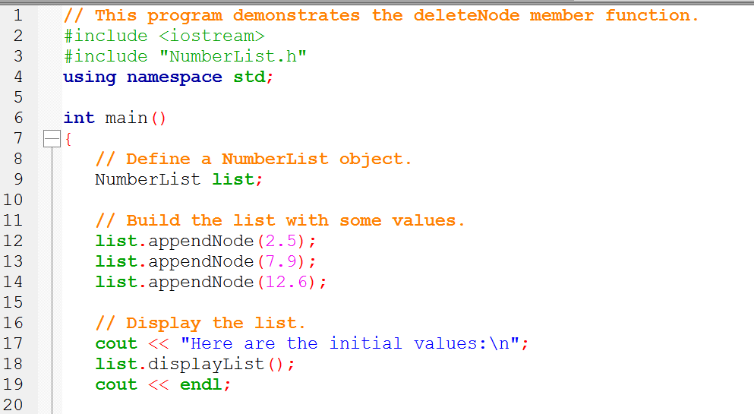

Slide 49
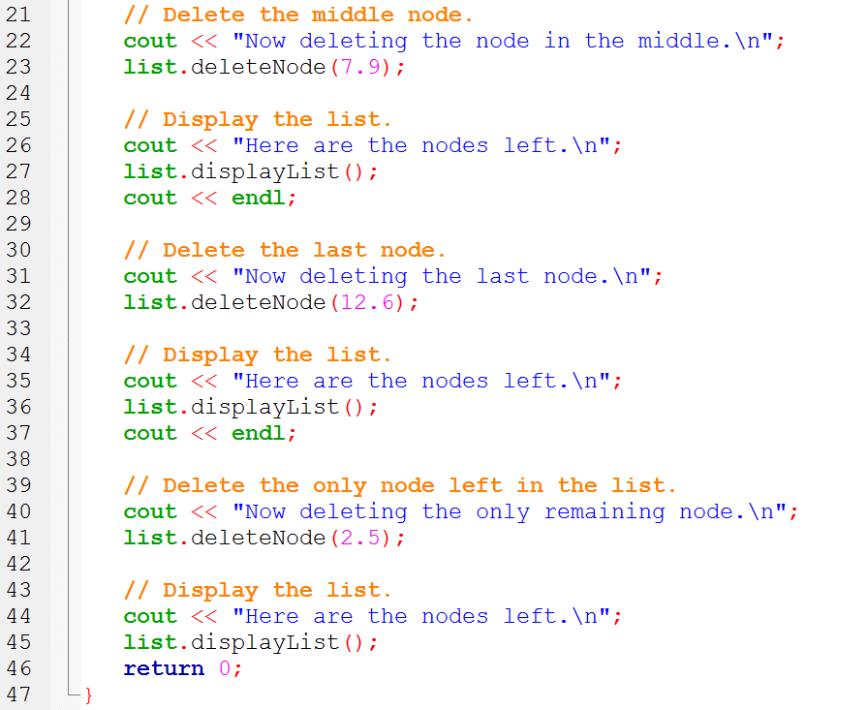

Slide 50
Destroying a Linked List
Must remove all nodes used in the list
To do this, use list traversal to visit each node
For each node,
Unlink the node from the list
If the list uses dynamic memory, then free the node’s memory
Set the list head to nullptr

Slide 51
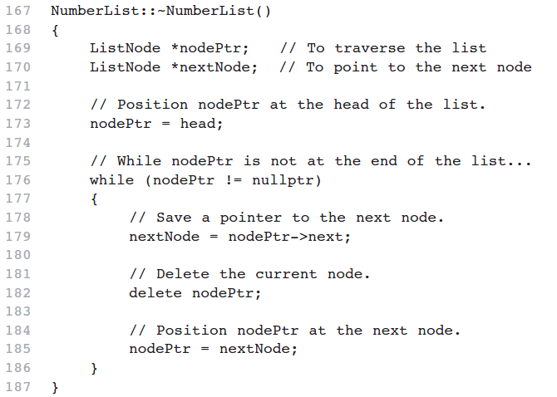

Slide 52
A Linked List Template
When declaring a linked list, must specify the type of data to be held in each node
Using templates, can declare a linked list that can hold data type determined at list definition time

Slide 53
template <class T>
class LinkedList {
private:
struct ListNode {
T value; // The value in this node
struct ListNode *next; // To point to the next node
};
ListNode *head; // List head pointer
public:
LinkedList() { head = nullptr; }
~LinkedList();
// Linked list operations
void appendNode(T);
void insertNode(T);
void deleteNode(T);
void displayList() const;
};

Slide 54
template <class T>
class LinkedList {
private:
struct ListNode {
T value; // The value in this node
struct ListNode *next; // To point to the next node
};
ListNode *head; // List head pointer
public:
LinkedList() { head = nullptr; }
~LinkedList();
// Linked list operations
void appendNode(T);
void insertNode(T);
void deleteNode(T);
void displayList() const;
};
template <typename T>

Slide 55
Variations of the Linked List
Other linked list organizations:
doubly-linked list: each node contains two pointers: one to the next node in the list, one to the previous node in the list
5
13
19
null
list
head
null

Slide 56
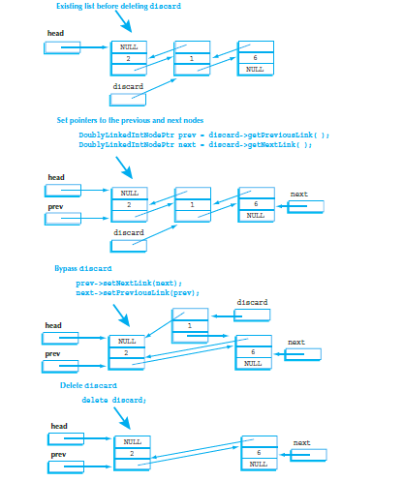

Slide 57
Variations of the Linked List
Other linked list organizations:
circular linked list: the last node in the list points back to the first node in the list, not to the null pointer
5
13
19
list
head

Slide 58

You can use

Slide 59
References
Slide contributions include:
Walter Savitch, Problem solving with C++ (9th Edition). Addison-Wesley Longman Publishing Co., Inc. Boston, MA, USA ©2015
Gaddis, Starting Out with C++: From Control Structures through Objects, (8th Ed.) , Addison-Wesley Longman Publishing Co., Inc. Boston, MA, USA ©2015
Bjarne Stroustrup, The C++ Programming Language, 3rd Edition, Addison-Wesley Longman Publishing Co., Inc. Boston, MA, USA ©2007
Herb Sutter, Andrei Alexandrescu, C++ coding standards : 101 rules, guidelines, and best practices, Copyright © 2005 Pearson Education, Inc.
Paul Deitel & Harvey Deitel, C++ How to Program, (7th Ed.) © 2010 by Pearson Education, Inc.
Upper Saddle River, New Jersey 07458
Scott Meyers, Effective Modern C++. Copyright © 2015 (O’Reilly) , 978-1-491-90399-5.
Andrew Koenig and Barbara E. Moo, Accelerated C++ Practical Programming by Example,
Addison-Wesley, 2000 ISBN 0-201-70353-X

Slide 60
References
Slide contributions include:
Frank M. Carrano. Data Abstraction & Problem Solving with C++ (5th Edition)
Addison-Wesley Longman Publishing Co., Inc. Boston, MA, USA ©2006
TutorialsPoint - http://www.tutorialspoint.com/cplusplus/
Cplusplus.com - http://www.cplusplus.com/doc/tutorial/

